Slide 1


Programming Clinic week4 individual project
Digital Bookstore
12.2.24 JingwenLi

Slide 2
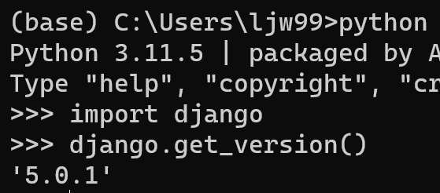
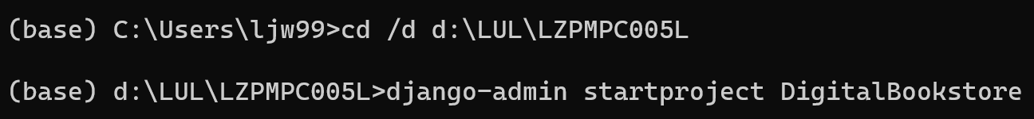
Check that django was installed successfully
Command reference website
https://blog.csdn.net/qq_43517653/article/details/99326894
Notes:
First of all, we should make sure Django is downloaded.
So we can type the command "python" to check the version of it. And then type these two commands to check the version of Django.

Slide 3
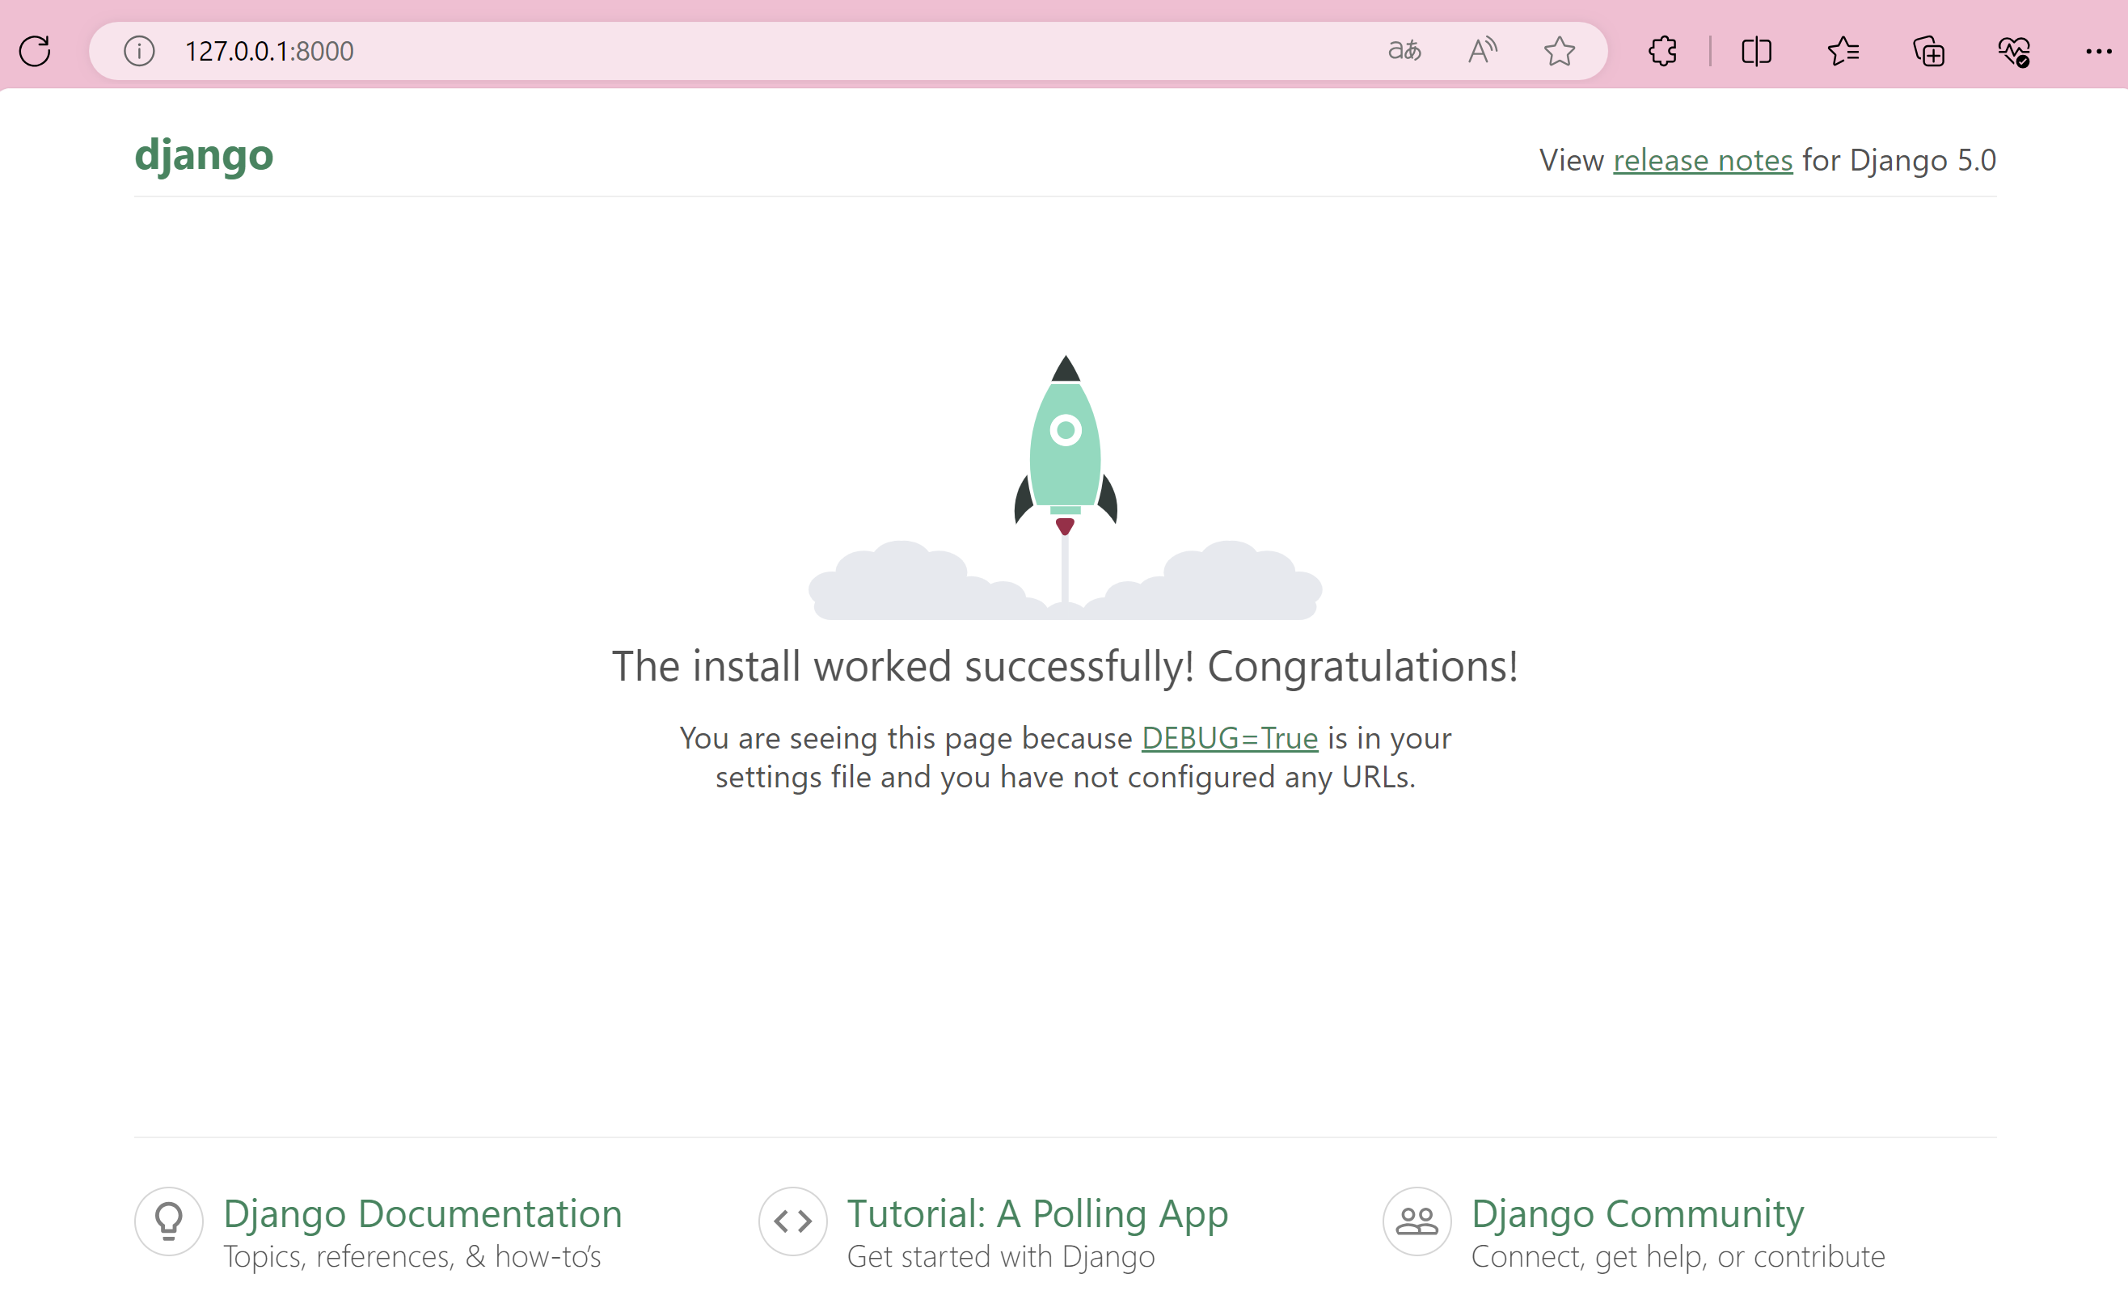
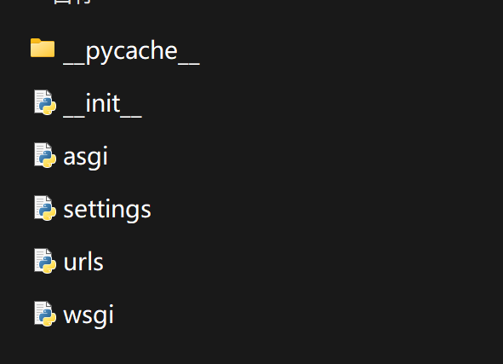
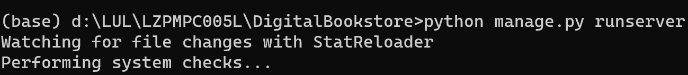
http://127.0.0.1:8000/

Slide 4
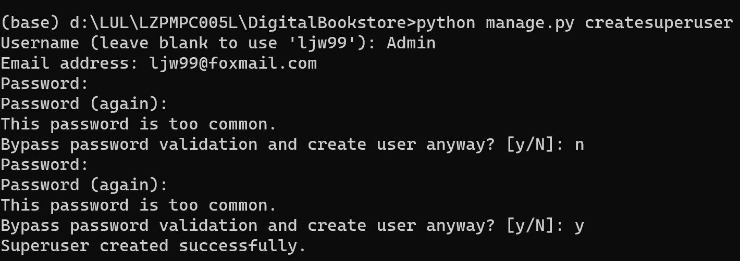
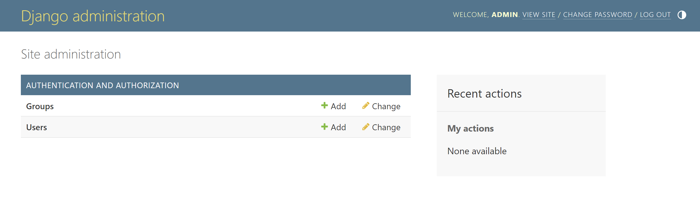
Adding a Super Administrator
Notes:
First of all, we should make sure Django is downloaded.
So we can type the command "python" to check the version of it. And then type these two commands to check the version of Django.

Slide 5
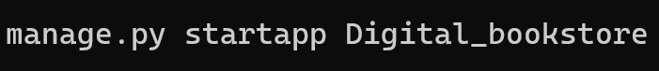
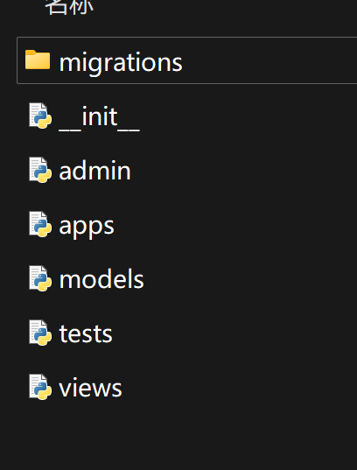
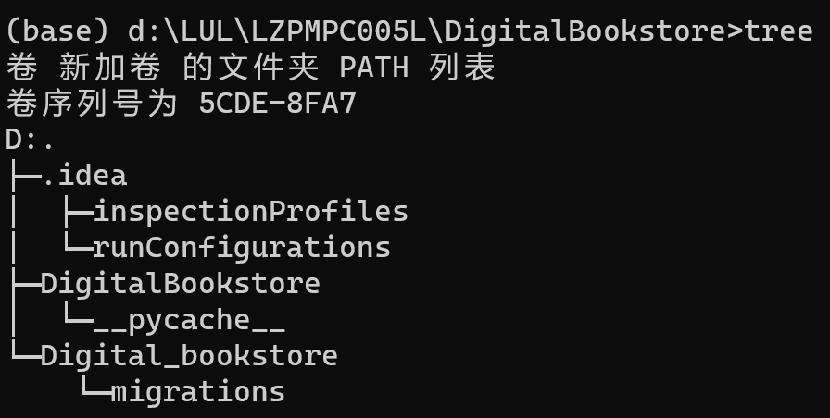
Adding a application
Notes:
First of all, we should make sure Django is downloaded.
So we can type the command "python" to check the version of it. And then type these two commands to check the version of Django.

Slide 6
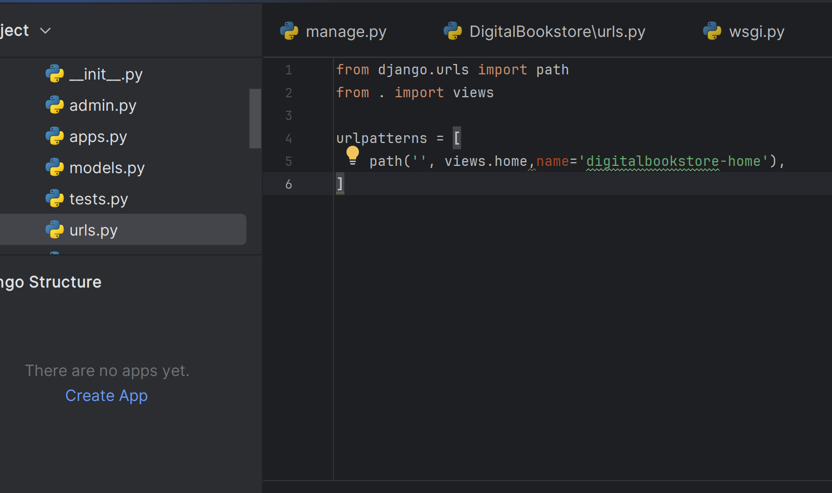
Have url path for homepage mappled to function in the views file
Notes:
First of all, we should make sure Django is downloaded.
So we can type the command "python" to check the version of it. And then type these two commands to check the version of Django.

Slide 7
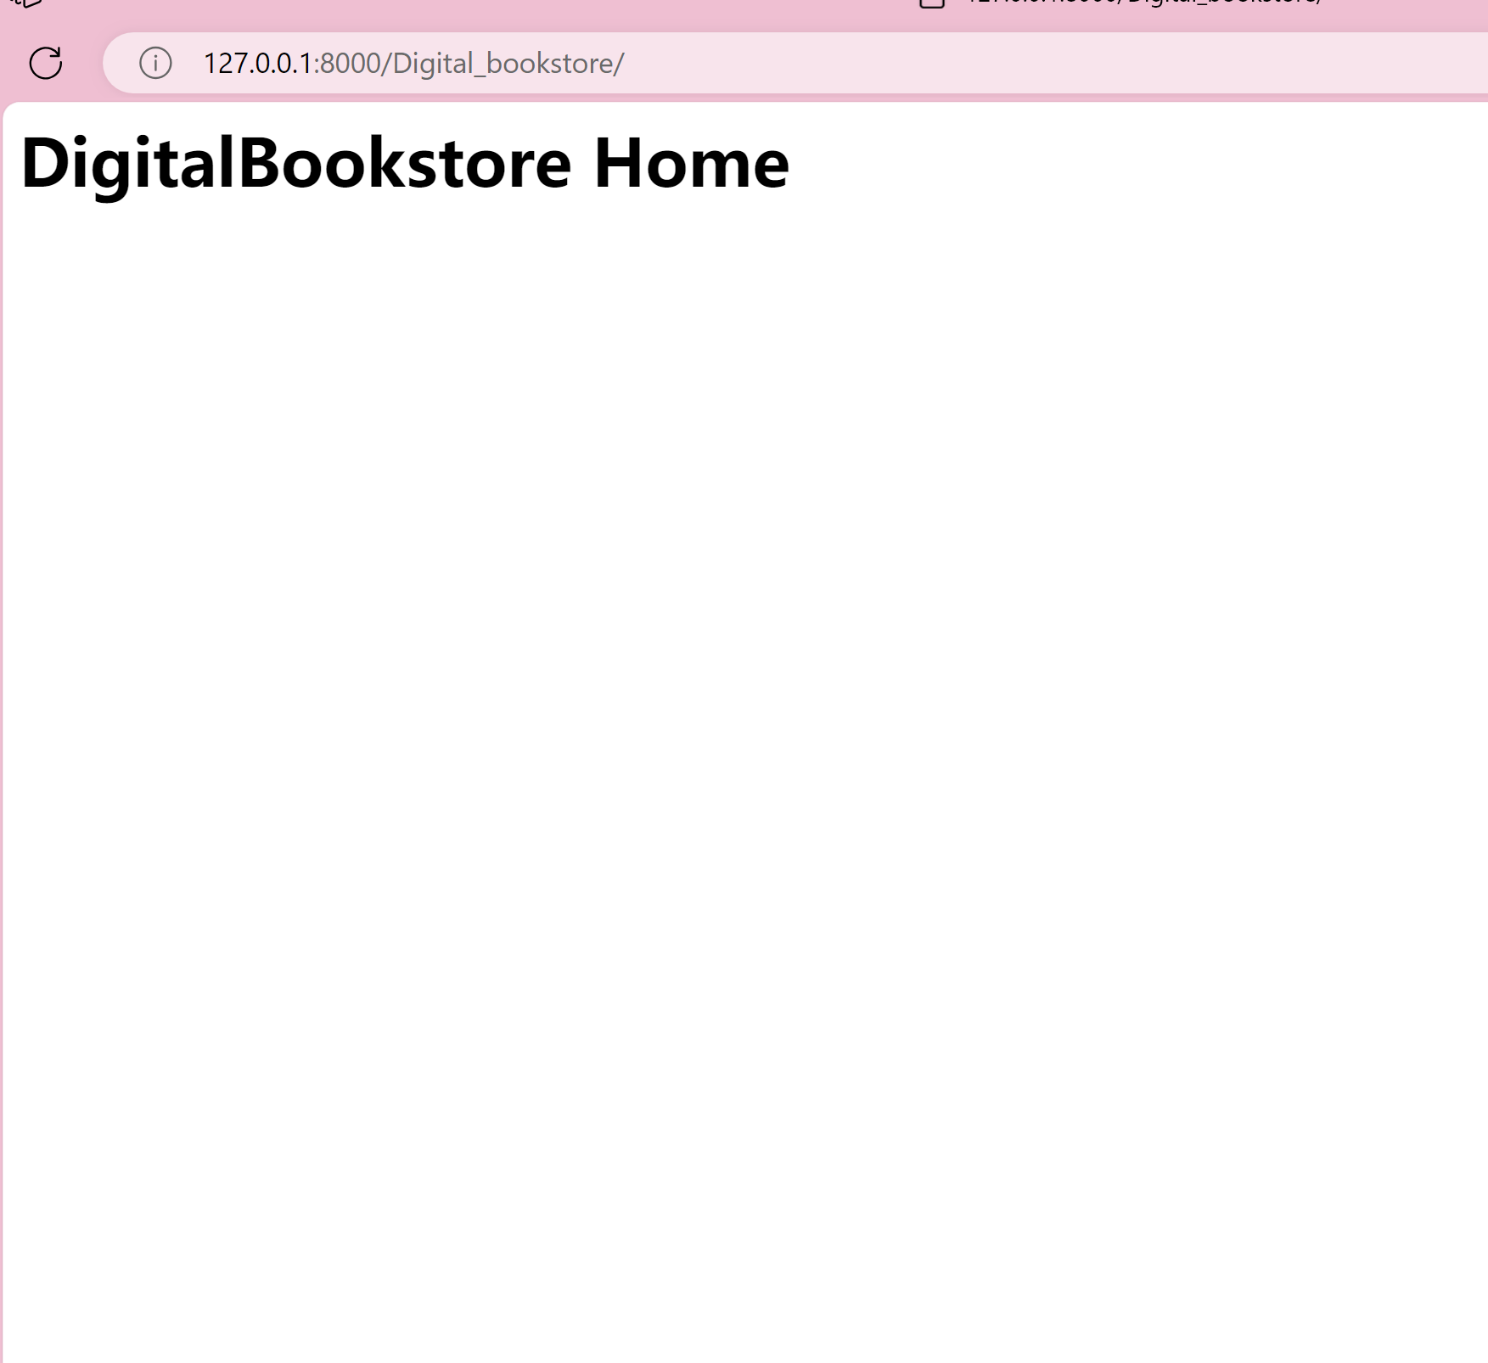
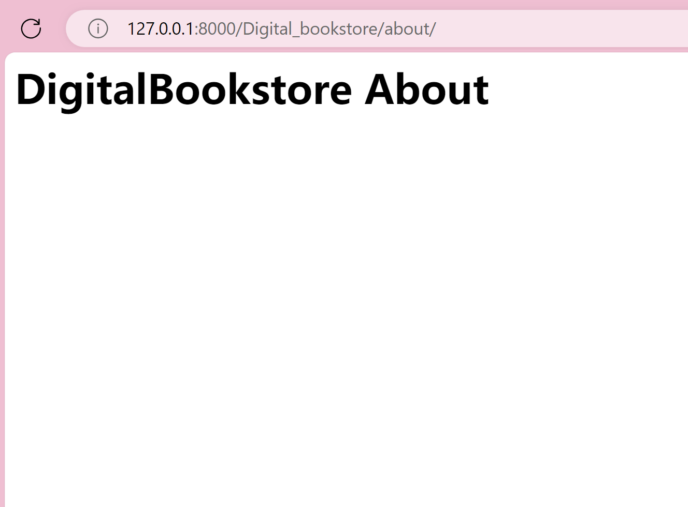
Create a path for the homepage and about page-
add templates later
Notes:
First of all, we should make sure Django is downloaded.
So we can type the command "python" to check the version of it. And then type these two commands to check the version of Django.

Slide 8
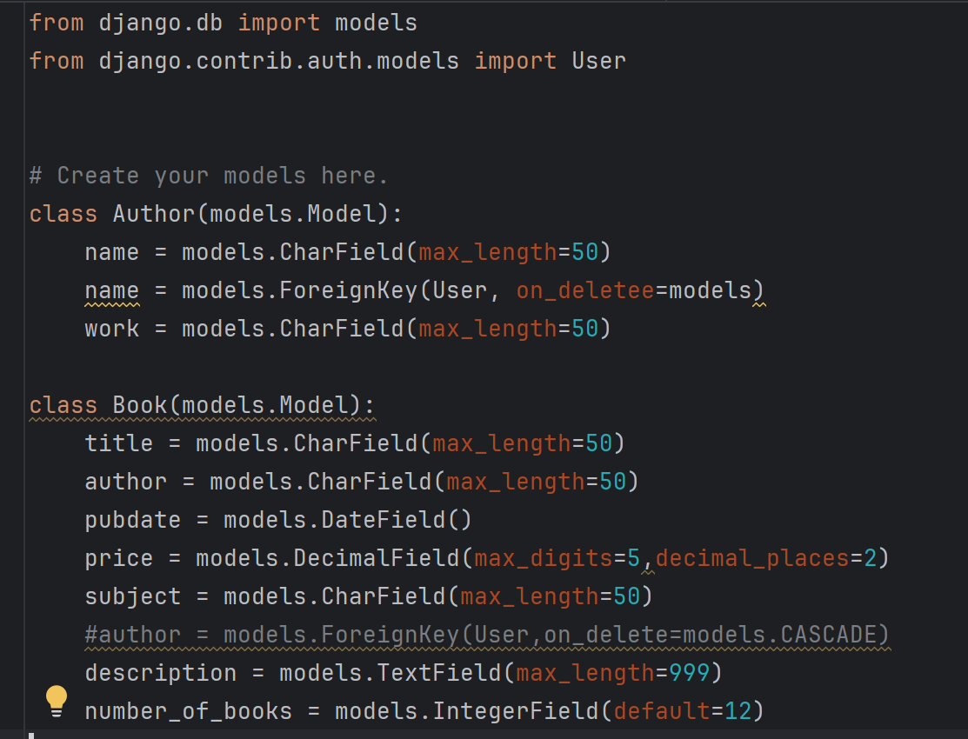
Create classes and attributes
Book
Book
Author
Book
Book
Author
Author
Book
Author
Author
Notes:
First of all, we should make sure Django is downloaded.
So we can type the command "python" to check the version of it. And then type these two commands to check the version of Django.

Slide 9
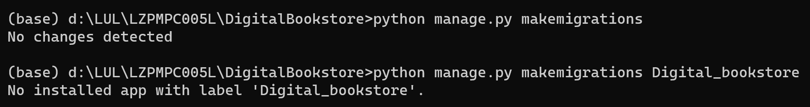
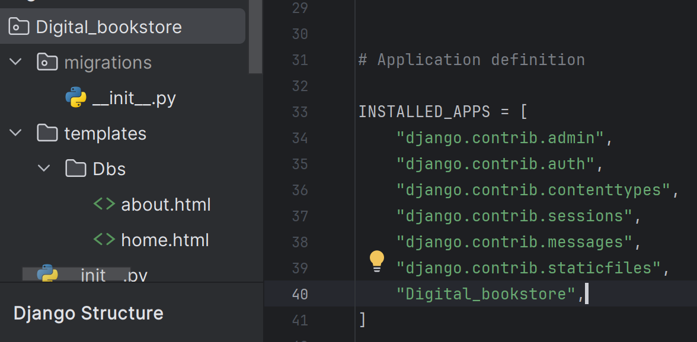
Migrations of databse
add app name in INSTALLED_APPS（setting.py)
Notes:
First of all, we should make sure Django is downloaded.
So we can type the command "python" to check the version of it. And then type these two commands to check the version of Django.

Slide 10
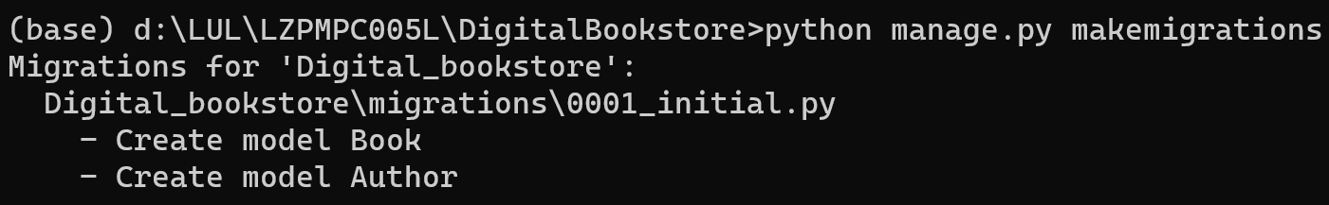
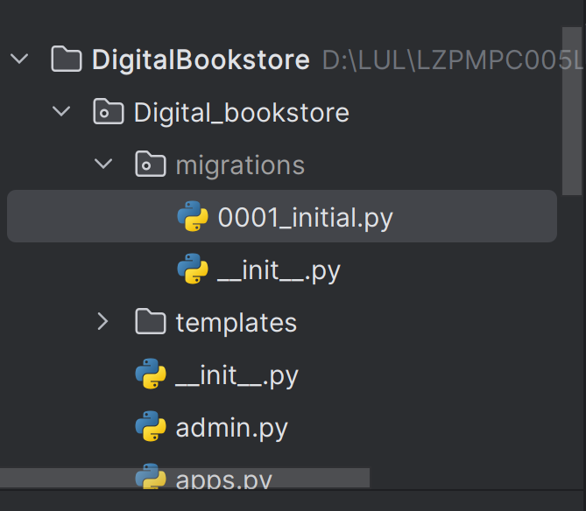
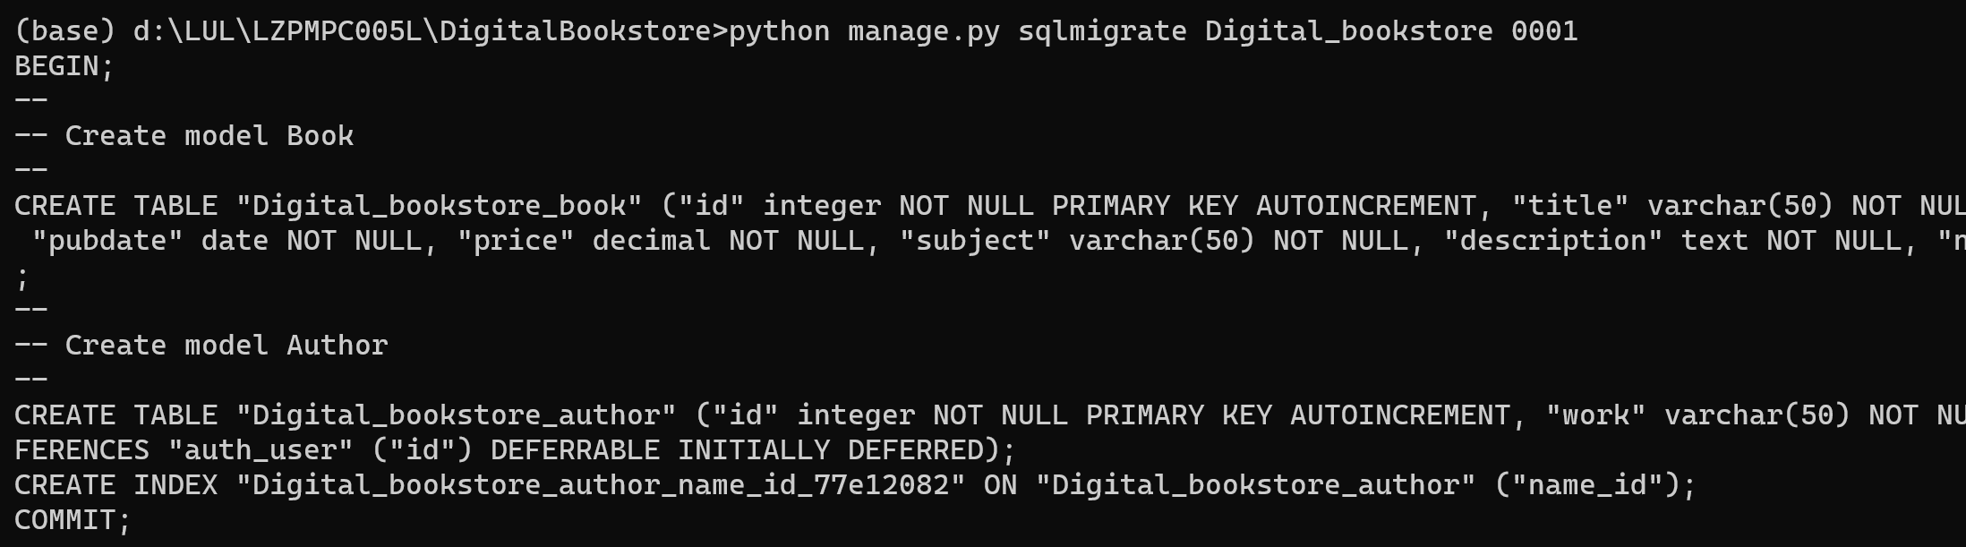
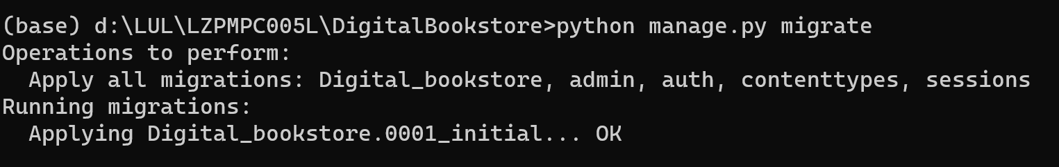
Migrations of databse
check at the sidebar
Notes:
First of all, we should make sure Django is downloaded.
So we can type the command "python" to check the version of it. And then type these two commands to check the version of Django.

Slide 11
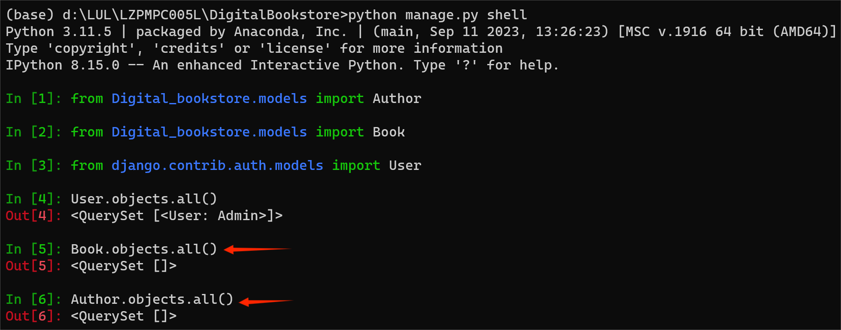
Retrieve
by now there is no book and no author
Notes:
First of all, we should make sure Django is downloaded.
So we can type the command "python" to check the version of it. And then type these two commands to check the version of Django.

Slide 12
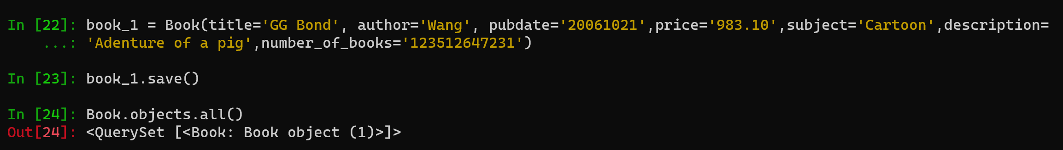
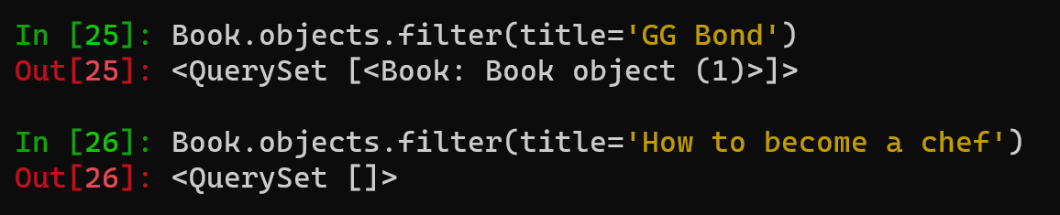
Add a book and retrieve and filter
Notes:
First of all, we should make sure Django is downloaded.
So we can type the command "python" to check the version of it. And then type these two commands to check the version of Django.

Slide 13
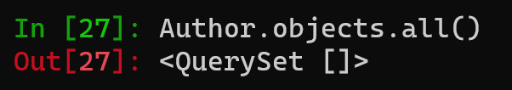
Problems
How do I add a book to the author's list at the same time?
Notes:
First of all, we should make sure Django is downloaded.
So we can type the command "python" to check the version of it. And then type these two commands to check the version of Django.

Slide 14
Thanks for whatching and listening

